Slide 1

Jad Kang – Project Manager Robert Orlando – QA testing Alex Durant – UI/UX Zacheary Vang – Frontend Developer Ryan Mcarthur – Backend Developer Jeremiah Davis – Backend Developer

Slide 2
What is it
Meal plan and shopping list creation tool, designed to make it easy to plan your meals for a week and shop for exactly what you need.

Slide 3
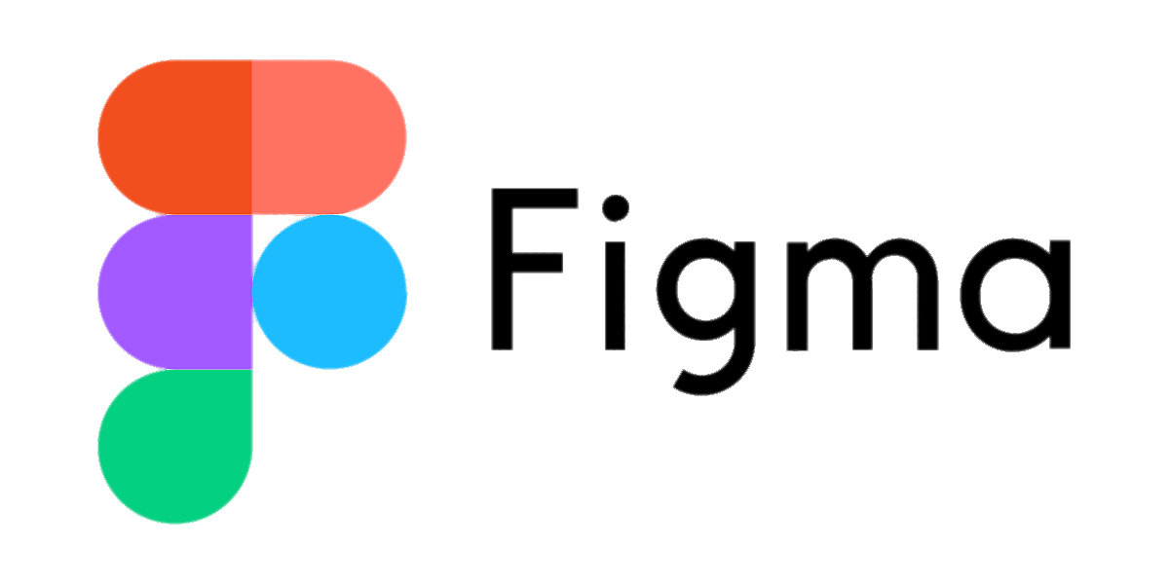
Functional Design

Slide 4
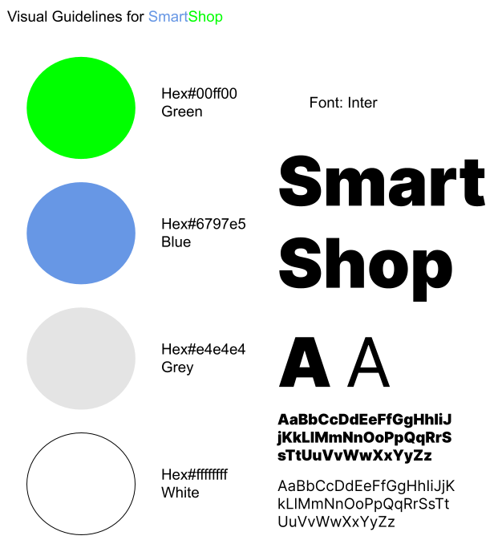
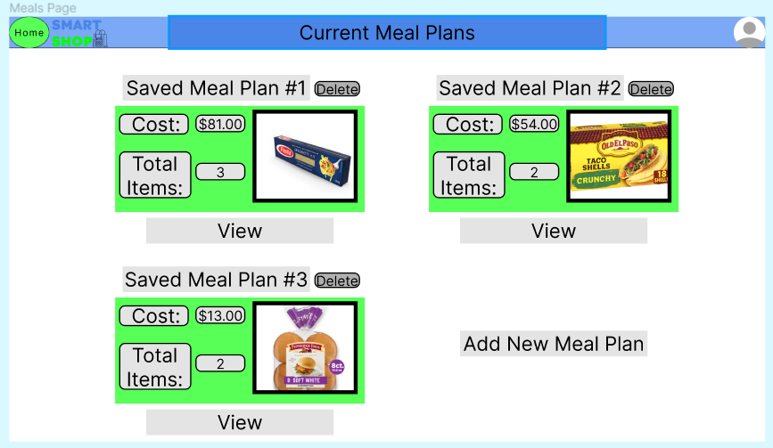
Visual Guidelines

Slide 5
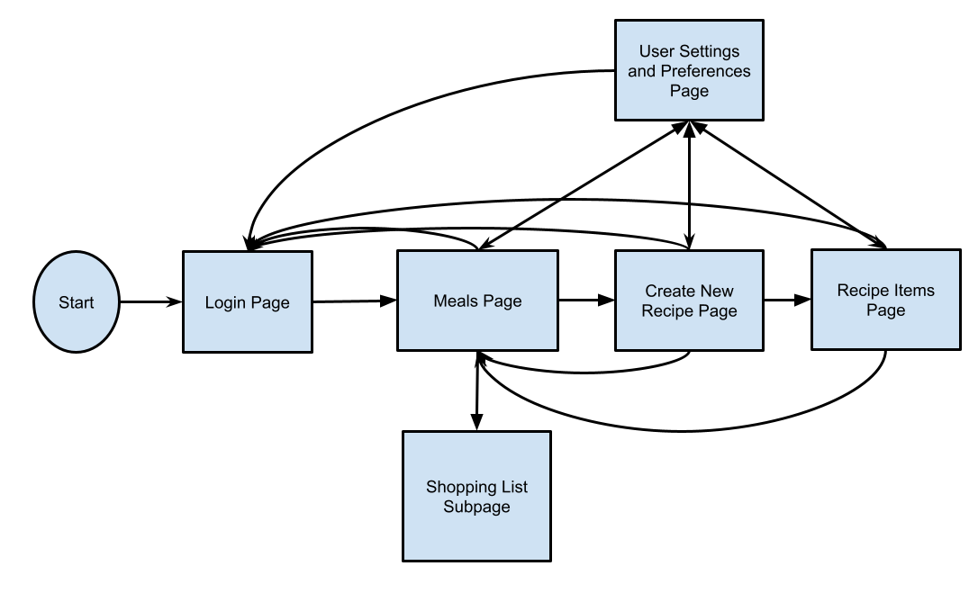
Flow Chart Visualization

Slide 6
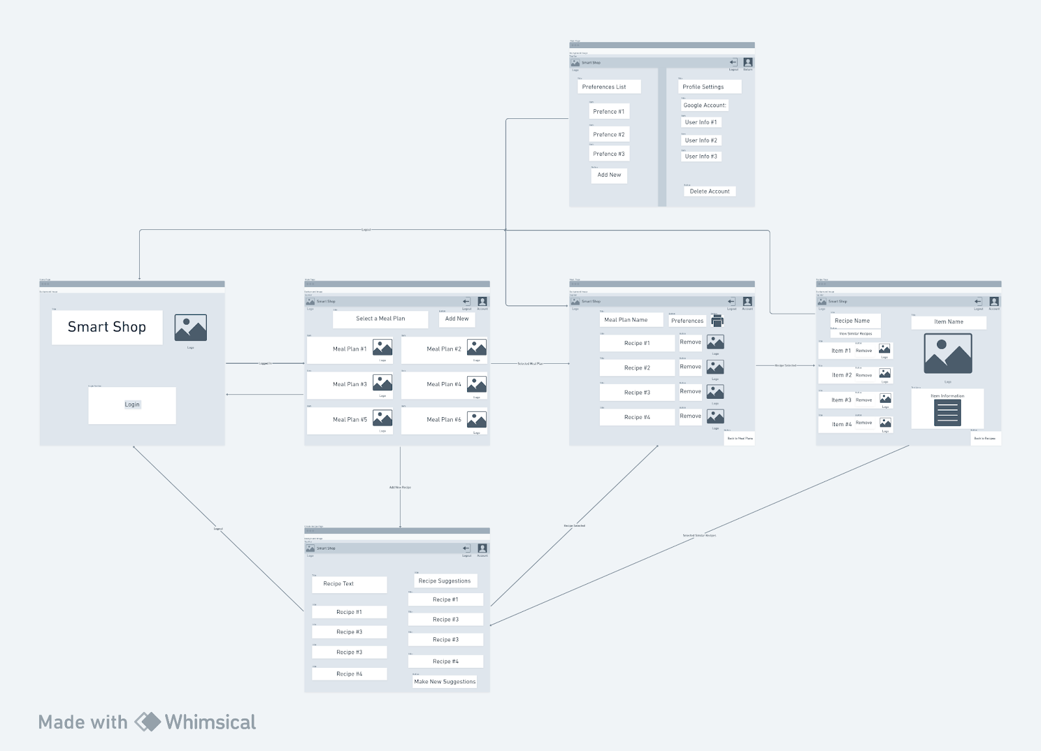
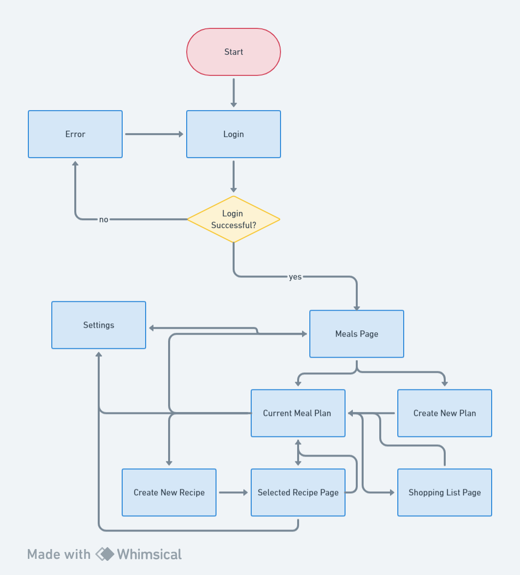
User Flow Chart and Wireframe
https://www.figma.com/file/wCE3aianafLlOY3j8v9ASv/TestForCSCI150?type=design&node-id=86%3A266&mode=design&t=aQJR8J9hyRZvGsBF-1

Slide 7
Technical implementation

Slide 8
Tech stack
Backend Architecture
Framework: Microsoft .Net Core 6.0 (LTS)
Database: Local databases for users, meal plans, and recipes
Communication: REST API for UI data retrieval and posting
Integration: Hosted in azure

Slide 9
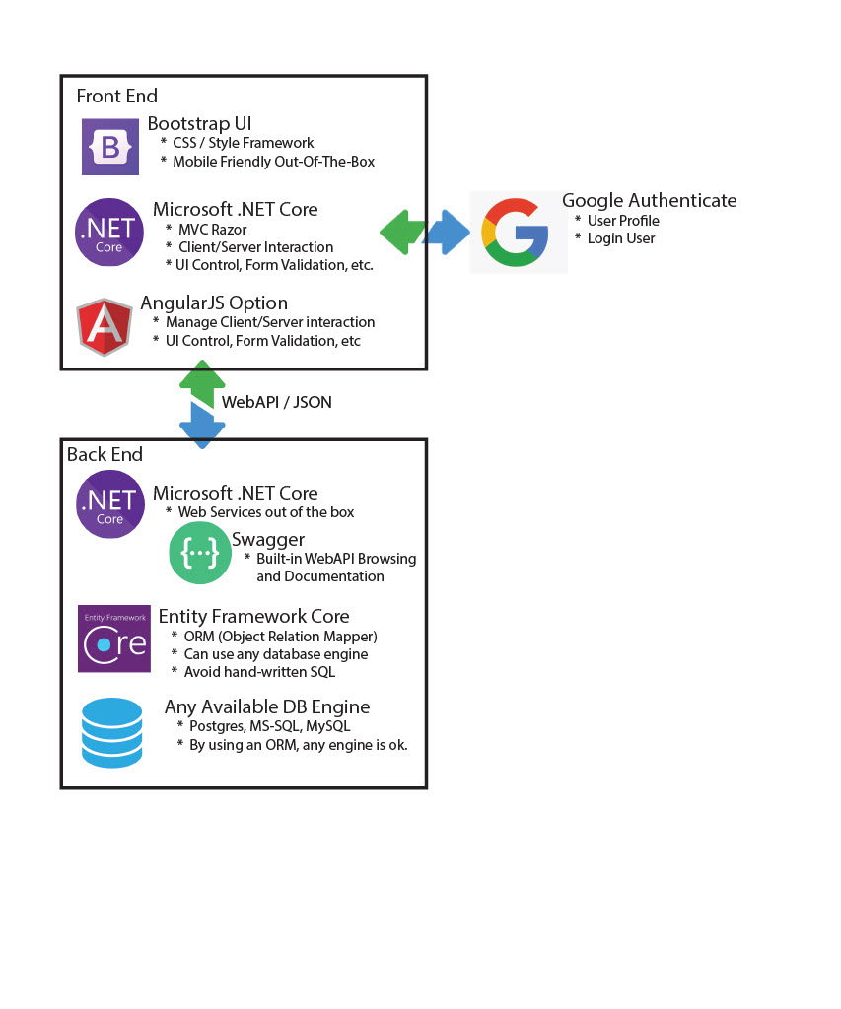
Tech stack
Database, Front End App and Back End App Hosted in Azure
REST API Endpoints
UI to Backend:
queries back end to call recipe api
Retrieves user data stored in database
Backend to Recipe API:
recipe search (for initial suggestions)
recipes by ingredients (for subsequent recipes).
Google to front end
Google authentication authorizes azure
User Interface Design
Frontend: HTML, CSS, JS
Color Palette: Soft colors with blue and green

Slide 10
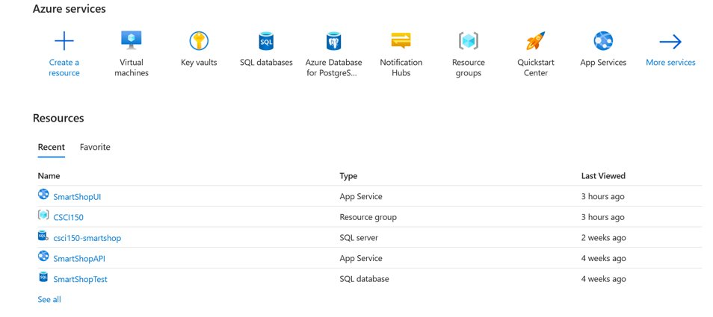
Tech Stack (Cloud Hosting - Azure)

Slide 11
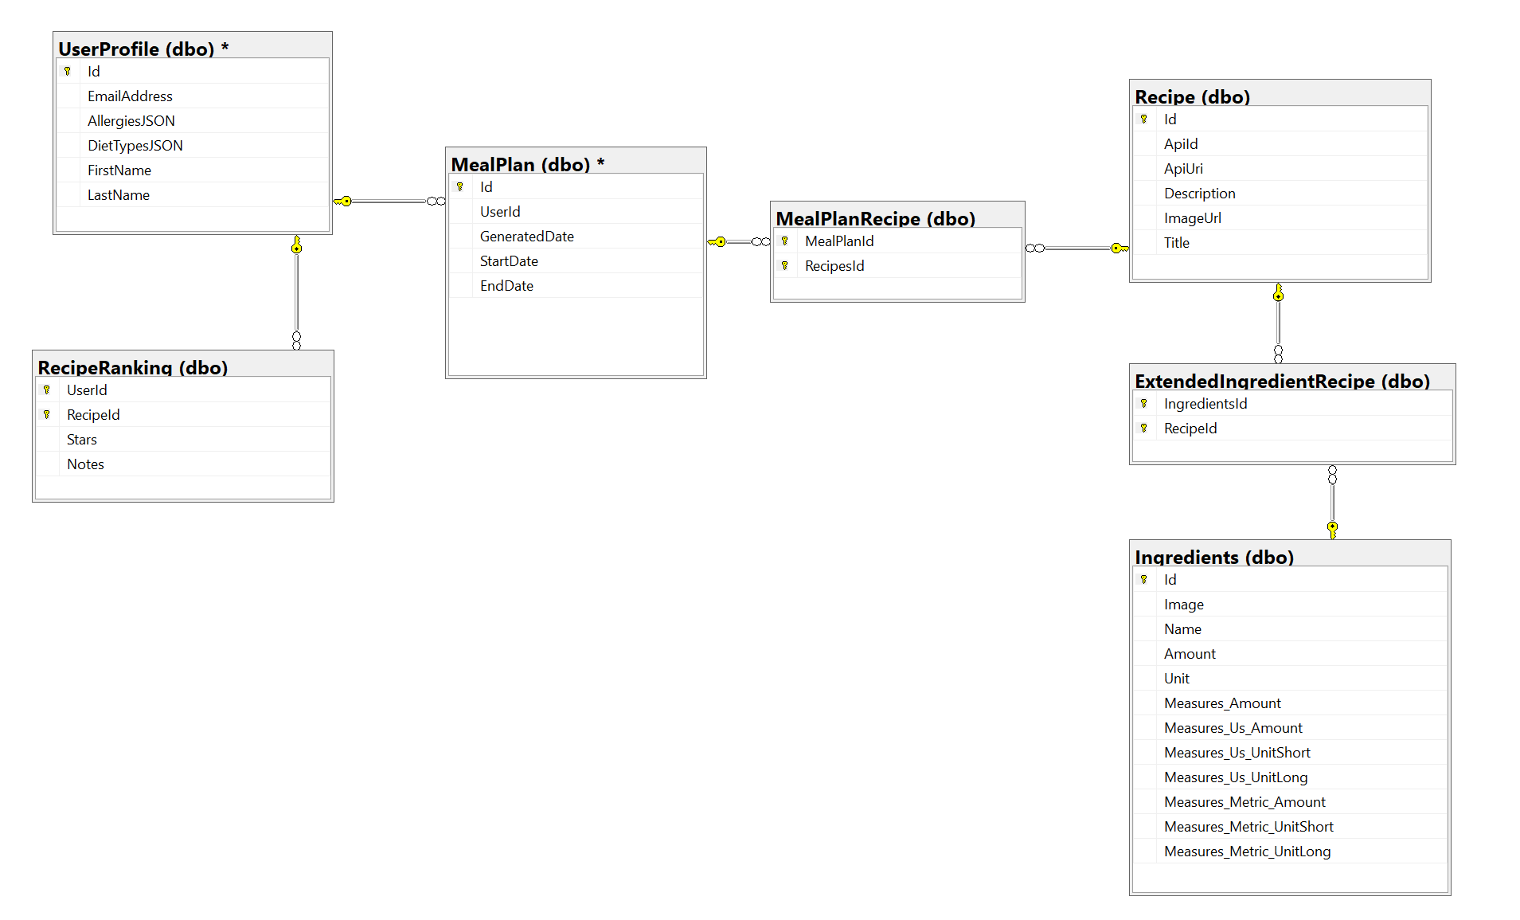
SmartShop SQL Schema

Slide 12
Project Plan
Identify priority of requirements and steps required to implement
Assign each step to group members
Milestone 1: UI/UX, Login, Classes and databases, frontend framework, SRS/SDD
Milestone 2: Frontend/Backend connection, API connections, improved documentation
Final: Implementing features to frontend, Cloud connection

Slide 13
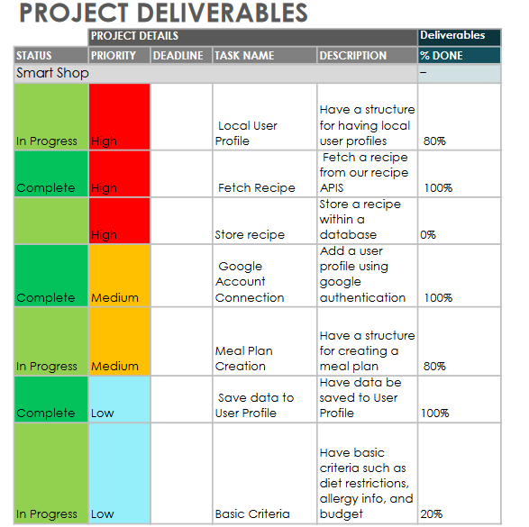

Slide 14
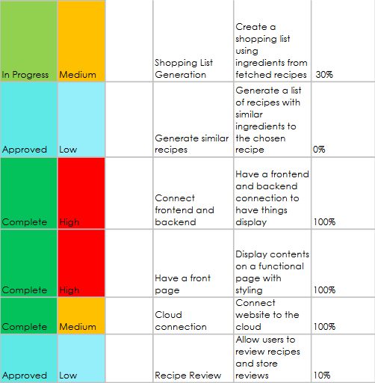

Slide 15
Future Plan
Fetch ingredients for specific meals
Allow for multiple recipes on the shopping list
Save recipes to meal plans
Improve accuracy and number of available criteria

